Slide 1
Web Design
Instructors: Paula Evans & Brandon Lim

Slide 2
Course Objectives
At the end of this class you will be able to:
Design and implement a professional website
Author web pages using HTML
Make stylistic decisions with CSS
Create interactive websites with JavaScript and jQuery

Slide 3
Course Objectives (cont.)
At the end of this class you will be able to:
Understand the client-server programming model and apply this to your designs
Create your own web site portfolio
Speak the web design lingo
Have fun with web design!

Slide 4
Why did you take the class?

Slide 5
The INTERNET… and a bit of history

Slide 6
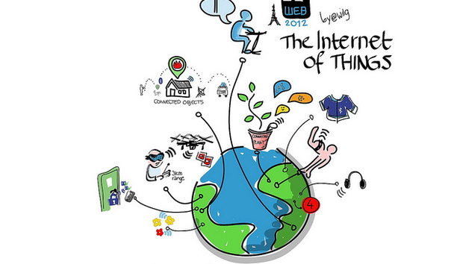
What is the internet?
http://https://www.youtube.com/watch?v=LVlT4sX6uVs
Notes:
Computer networks interconnected

Slide 7
What is the WWW?
Is the World Wide Web (WWW) and the internet the same?
https://www.youtube.com/watch?v=J8hzJxb0rpc
Notes:
the Web is the collection of web sites and pages around the world; the Internet is larger and also
includes other services such as email, chat, online games, etc.

Slide 8
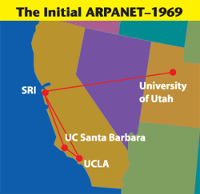
Brief history: http://www.internethalloffame.org/internet-history/timeline
Began as a US Department of Defense
network called ARPANET (1960s-70s)
E-mail is born -- 1971
Notes:
The first ARPANET link was established between the University of California, Los Angeles and the Stanford Research Institute on 22:30 hours on October 29, 1969
Store and forward, i.e. packet switching
Usenet is a world-wide distributed discussion system. It consists of a set of "newsgroups" with names that are classified hierarchically by subject. "Articles" or "messages" are "posted" to these newsgroups by people on computers with the appropriate software -- these articles are then broadcast to other interconnected computer systems via a wide variety of networks. Some newsgroups are "moderated"; in these newsgroups, the articles are first sent to a moderator for approval before appearing in the newsgroup. Usenet is available on a wide variety of computer systems and networks, but the bulk of modern Usenet traffic is transported over either the Internet or UUCP.

Slide 9
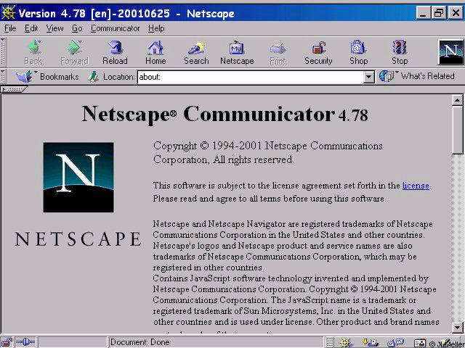
Brief history (cont.)
WWW created in 1989-91 by Tim Berners-Lee
Popular web browsers released:
Netscape 1994
IE 1995
Amazon.com opens in 1995
Google January 1996
Wikipedia launched in 2001
MySpace opens in 2003
Facebook February 2004

Slide 10
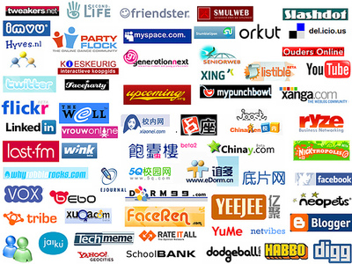
Wikipedia launched in 2001
MySpace opens in 2003
Facebook February 2004
Notes:
Which of these do you recognize?

Slide 11
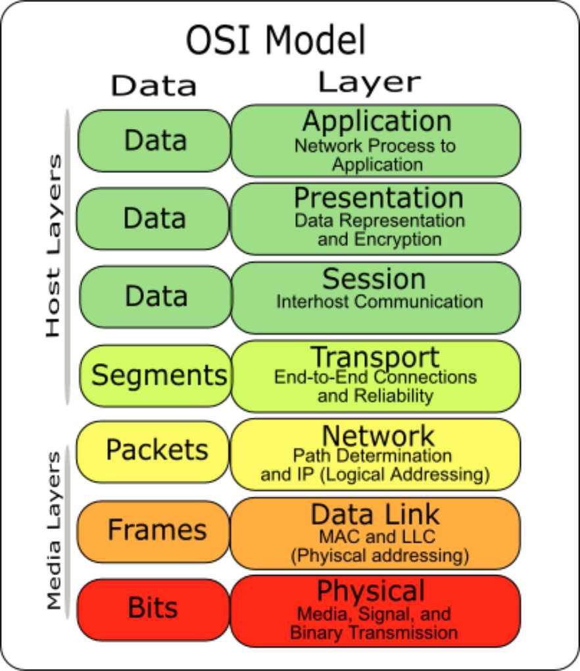
Layered architecture
Notes:
physical layer : devices such as ethernet, coaxial cables,
fiber-optic lines, modems
data link layer : basic hardware protocols (ethernet, wifi,
DSL PPP)
network / internet layer : basic software protocol (IP), switching and routing, virtual circuits
transport layer : adds reliability to network layer (TCP,
UDP)
Session: This layer establishes, manages and terminates connections between This layer establishes, manages and terminates connections between applications
Presentation: This layer provides independence from differences in data representation (e.g., encryption) by translating from application to network format, and vice versa.
application layer : implements specific communication for each kind of program (HTTP, POP3/IMAP, SSH, FTP)

Slide 12
Internet Protocol (IP)
Simple protocol for data exchange between computers
IP Addresses:
32-bit for IPv5
128-bit for IPv6
Notes:
find out your internet IP address: whatismyip.com find out your local IP address: in a terminal, type: ipconfig (Windows) or ifconfig (Mac/Linux
Routers forward data based on tables
IP is simple: no corruption check, no sequencing, no data loss assurance, no duplication

Slide 13
Web Browser
Web browser: fetches/displays documents from web servers
Mozilla Firefox
Microsoft Internet Explorer (IE)
Apple Safari
Google Chrome
Opera
Notes:
Explorer pain

Slide 14
Web Languages
Hypertext Markup Language (HTML): used for writing web pages
Cascading Style Sheets (CSS): stylistic info for web pages
JavaScript: interactive and programmable web pages

Slide 15
Hypertext Markup Language (HTML)
Describes the content and structure of information on a web page
Not the same as the presentation (appearance on screen)
Surrounds text content with opening and closing tags
Each tag's name is called an element
syntax: <element> content </element>
example: <p>This is a paragraph</p>
Notes:
- most whitespace is insignificant in HTML
Content is the key word for html. It does not describe style!!
Scripts for behavior, css for styling

Slide 16
Structure of HTML page
<HTML>
<head>
information about the page
</head>
<body>
page contents
</body>
</html> HTML
HTML is saved with extension .html
Basic structure: tags that enclose content, i.e., elements
Header describes the page
Body contains the page’s contents

Slide 17
Page Title <title>
…
<head>
<title> HARRY POTTER AND THE DEATHLY HALLOWS - PART 2 </title>
</head>
… HTML
Placed within the head of the page
Displayed in web browser’s title mark and when bookmarking the page

Slide 18
Headings <h1>, <h2>, … <h6>
<h1> Harry Potter </h1>
<h2> Books </h2>
<h3> Harry Potter and the Philosopher’s Stone </h3>
HTML
Harry Potter
Books
Harry Potter and the Philosopher’s Stone
output
Notes:
- Every tag has a meaning. This meaning is related to structure and content, not style!
- H1 is for top level heading, h2 is for sublevel. These are not for size!!!
Why use semantic html? More compatible with browsers, better style

Slide 19
Paragraph <p>
…
<body>
<p> Harry Potter and the Deathly Hallows,
the last book in the series, begins directly after the events of the sixth book.
Voldemort has completed his ascension to power and gains control of the Ministry of Magic</p>
</body>
… HTML
Harry Potter and the Deathly Hallows, the last book in the series, begins directly after the events of the sixth book. Voldemort has completed his ascension to power and gains control of the Ministry of Magic
output
Placed within the body of the page
Notes:
Observe that line breaks and spaces do not appear in output

Slide 20
Links <a>
<p>
Search
<a href="http://www.google.com/">Google</a>
now!
</p> HTML
Search Google now! output
The href attribute specifies the destination URL
Links or anchors are inline elements, so they must be placed inside a block element such as a p or h1
Notes:
Choose a descriptive link text!!

