Slide 1
Day 2
Object Oriented Programming

Slide 2
Why OOP
https://www.youtube.com/watch?v=qb-hfSRpuVk&feature=player_embedded

Slide 3
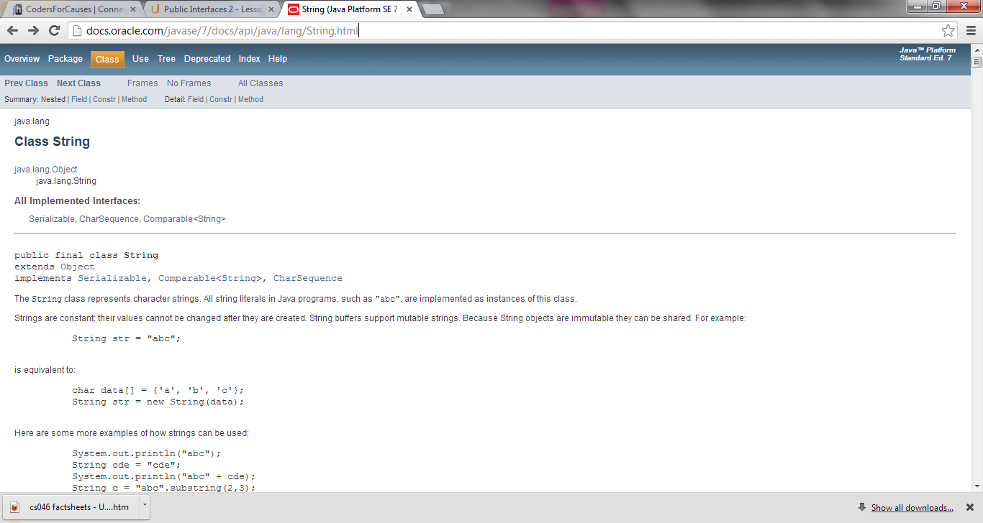

Slide 4
String Documentation
Method | Number of Parameter(s) | Parameter Type(s) | Return Type
length()
substring(__ ,__ )
toUpperCase()
indexOf(___)

Slide 5
First Object: Day Object—Create a ‘Day Class’ First

Slide 6
Class Website: Files are stored here
http://www.codersforcauses.com/
Notes:
Go to Day 2, open Day, copy code, paste in Day class.

Slide 7
Class-Objects-Methods-Parameters
Class—Day
Create new Object: day1 (this is an instance of the Day class)
What are the methods? Parameters?
______________ ______________
______________ ______________
______________ ______________
______________ ______________
______________ ______________
______________ ______________

Slide 8
Complete Exercise 1

Slide 9
What methods are defined by the Day classes that can be used by these objects?

Slide 11
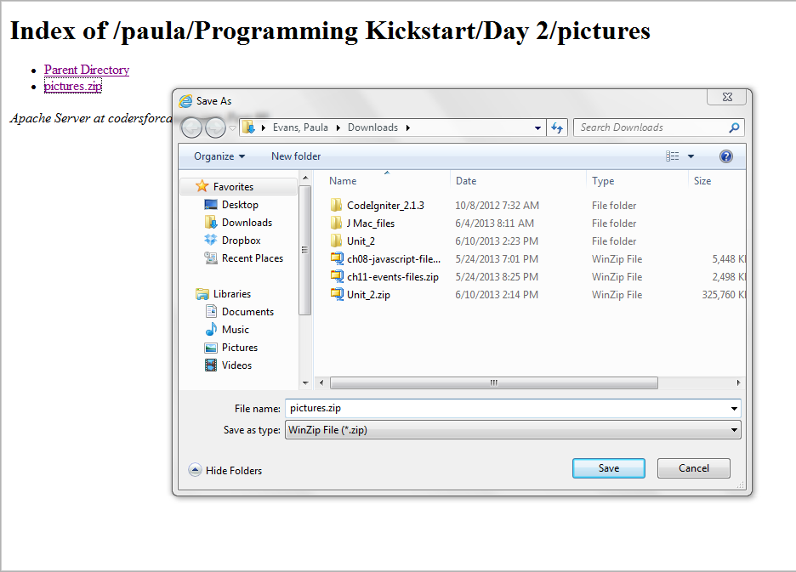

Slide 13
Variable Names
See Exercise 3: Download & unzip pictuers2

Slide 17
Comments—Open the Color Class
public class Cone
{
/**
* Gets the volume of a cone
* @param r the radius of the cone
* @param h the height of the cone
*/
public double volume(int r, int h)
{
double volume;
// volume = (1/3)π*radius^2*height
volume = (1.0/3.0)*Math.PI*r*r*h return volume;
}
}

Slide 18
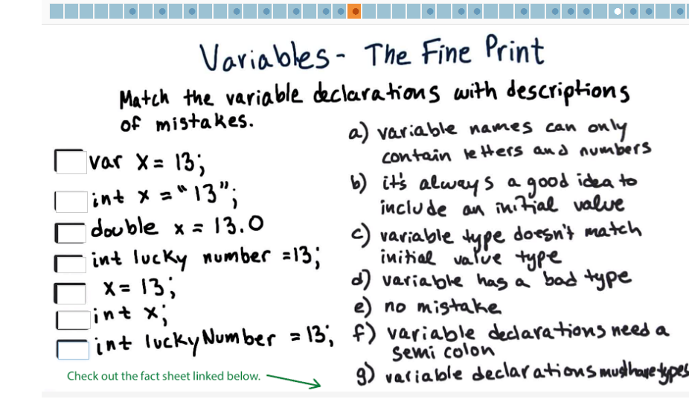
Resources Sheet: Java Facts:

Slide 19
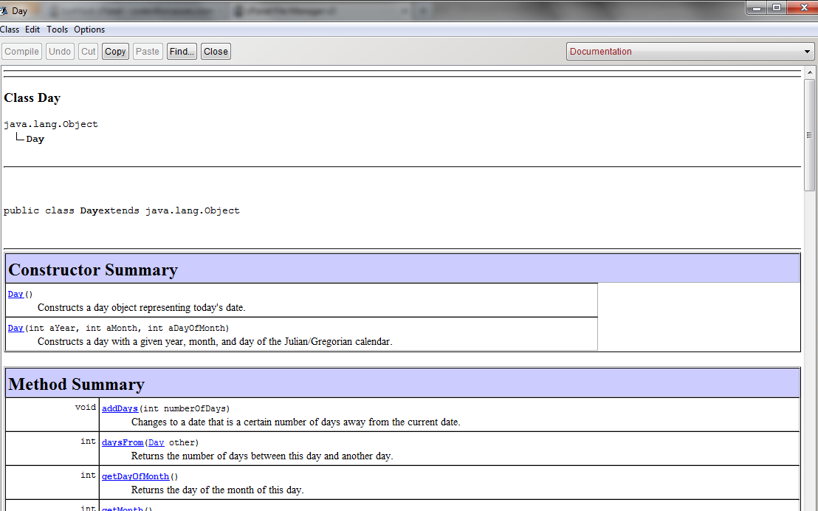
Documentation View—See Exercise 4—days2 project

