Slide 1
Day 8: Fruit Loops: Color

Slide 2
Loop Review
What does the following loop print?
for (int i= 0; i<5; i++)
{
for (int j=0; j<4; j++)
{
System.out.println(“i: “+i+” j: “+j);
}
System.out.println();
}

Slide 3
Scope Review How many rectangles are printed?
Rectangle box = new Rectangle(0,0, 20, 20);
box.setColor(new Color(255, 0,0));
for (int i=0; i< 8; i++)
{
box.fill();
box.translate(i,i);
}

Slide 4
Scope Review—How many rectangles are printed?
for (int i=0; i< 8; i++)
{
Rectangle box = new Rectangle(0,0, 20, 20);
box.setColor(new Color(255, 0,0));
box.fill();
box.translate(i,i);
}

Slide 5
Color class
Constructor Detail
Color
public Color(int red, int green, int blue)
Constructs a new Color object.
Parameters:
red - the red value of the color (between 0 and 255)
green - the green value of the color (between 0 and 255)
blue - the blue value of the color (between 0 and 255)

Slide 6
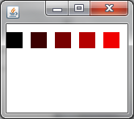
Color Wheel
Color(0,0,0)
Color(60,0,0)
Color(120,0,0)
Color(180,0,0)
Color(240,0,0)
Note: each Color parameter ranges from 0 to 255

Slide 7
Loop to vary the colors
for(int j=0; j<5; j++)
{
Rectangle box = new Rectangle(i*30, j*30, 20, 20);
box.setColor(new Color(i*60,0,0));
box.fill();
}
Remember: Color(0,0,0) is black and Color(255,0,0) is pure red

Slide 8
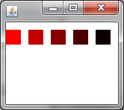
What will this print?
for(int j=0; j<5; j++)
{
Rectangle box = new Rectangle(i*30, j*30, 20, 20);
box.setColor(new Color(255-i*60,0,0));
box.fill();
}

Slide 9
Exercise 1
Fruit Loops
Loops and Color

Slide 10
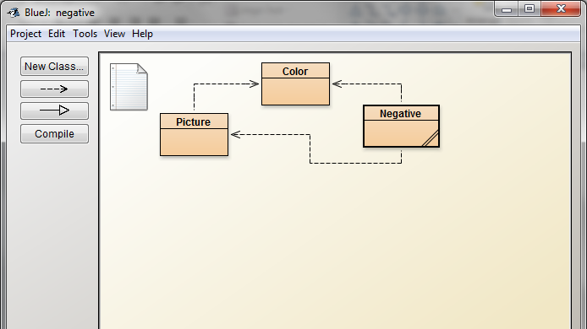
Pictures need Color
Explanation and review for Exercise 2

Slide 11
Picture Class Methods

Slide 12
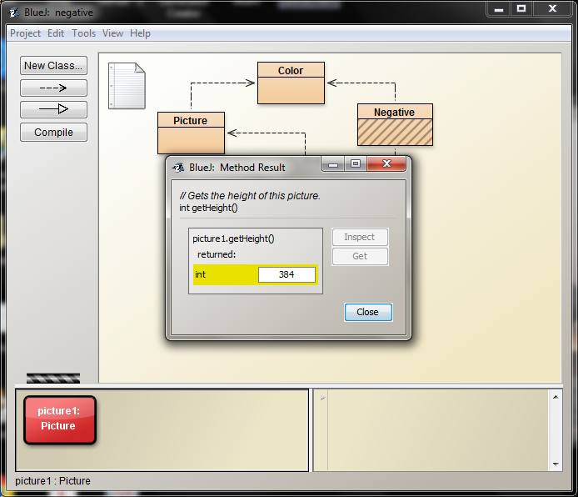
getHeight()—the height in pixels is returned as an int

Slide 13
In Class practice
getHeight() – returns an int
getWidth() – returns an int
getColorAt(int x, int y ) – returns a Color
(Note: Color has 3 int parameters, red, green & blue. These values range from 0 to 255)
Instantiate a returned Color and get its red, green and blue int values

Slide 14
Exercise 2
Create negatives, darken and brighten pictures

