Slide 1
Day 7: Loop Algorithms
We get to see our old projects, too!

Slide 2
Loop Review—what is the output?
for (int i=0; i<5; i++)
{
System.out.println(i);
}

Slide 3
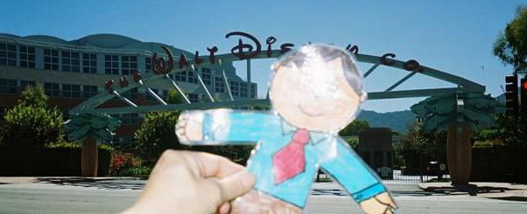
Flat Stanley—gets around!

Slide 4
We will create some loops to move Stanley around

Slide 5
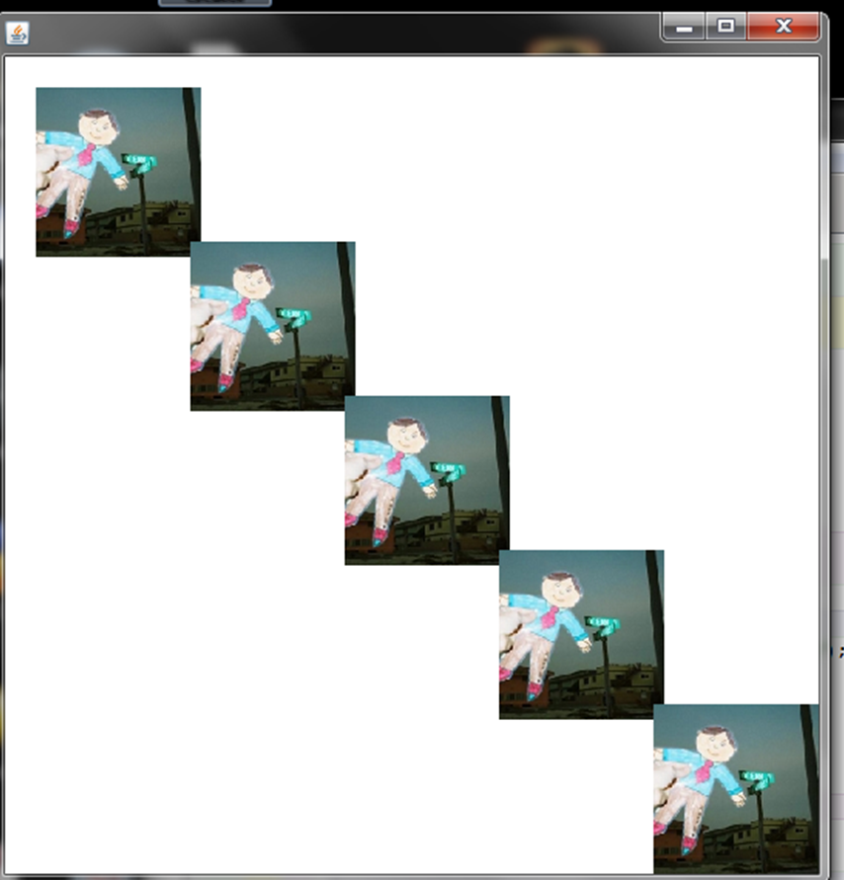
To make the work easier—let’s plan
The Picture constructor draws the picture starting at the top left corner. Let’s figure out the top left corner of each ppicture (Stanley is about 150 pixels by 150 pixels).

Slide 6
Exercise 1: Picture stanley matters!

Slide 7
More advanced loop algorithms
Sometimes, we need to go across and down or down and across or ….
for (______; _____; ______)
for (int ______; _________; _______)
 | 1 | 2 | 3
1
2
3
4

Slide 8
Sample nested for-loop
for( int row =1; row <=4; row++)
{
for ( int col =1; col <=3; col++)
{
System.out.println(“row: “+row+” col: “+col);
}
}

Slide 9
Flower class we made—we need the dimensions

Slide 10
Exercise 2
Trick:
for( int i = 0; i<10; i++)
{
stanley.translate(i*150,0);
}

