Slide 1
Day 6: Loops--Repetition

Slide 2
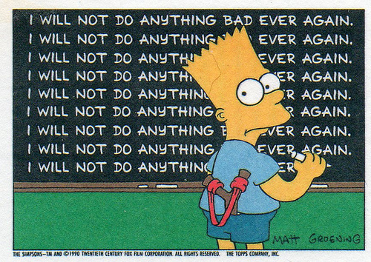
Poor Bart

Slide 3
Bart has to write this sentence
100 times:
I will not do anything bad ever again.
How can we help him?

Slide 4
Pseudocode
count = 1
While count <= 100
Write “I will not do any bad ever again.”
count = count + 1

Slide 5
While loop
// We start counting at 1
int count = 1;
// Then we repeat, while count is less than (or equal to) 100
while (count <= 100)
// We create the list of things he has to do each time
{
System.out.println(“I will not do …”);
count = count +1;
}

Slide 6
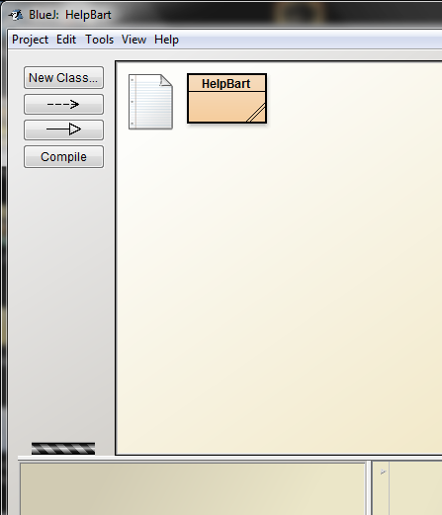
Exercise 1: Try this out for yourself—if things go crazy, though….
right-click on the
striped bar

Slide 7
For Loop—very popular type of loop
-- We will change our while loop until it is a for loop
int count = 1;
while (count <= 100)
{
System.out.println(“I will not do …”);
count = count +1;
}

Slide 8
Typical for loop
for(int count = 1; count <=100; count++)
{
System.out.println(count);
}

Slide 9
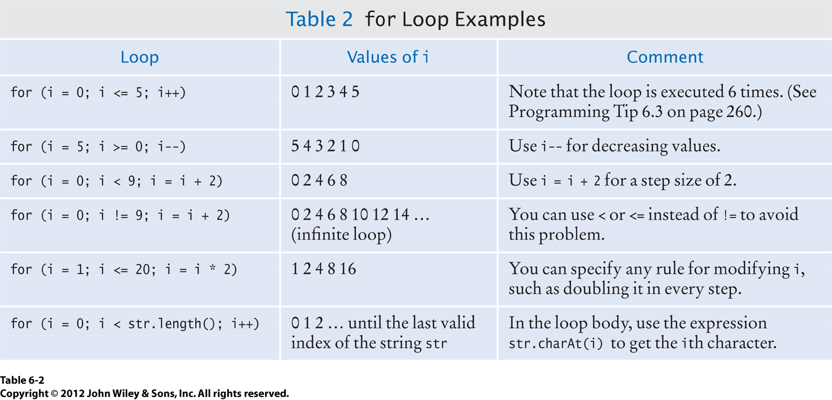
Exercise 2: Play with some for loops

Slide 10
String Review
String greeting = “Hello, World!”;
int n = greeting.length();
String little = greeting.substring(6, 11);
int positionIndex = greeting.indexOf(“World”);

