Slide 1
Day 4: Designing Classes
…to create objects which will interact with each other

Slide 2
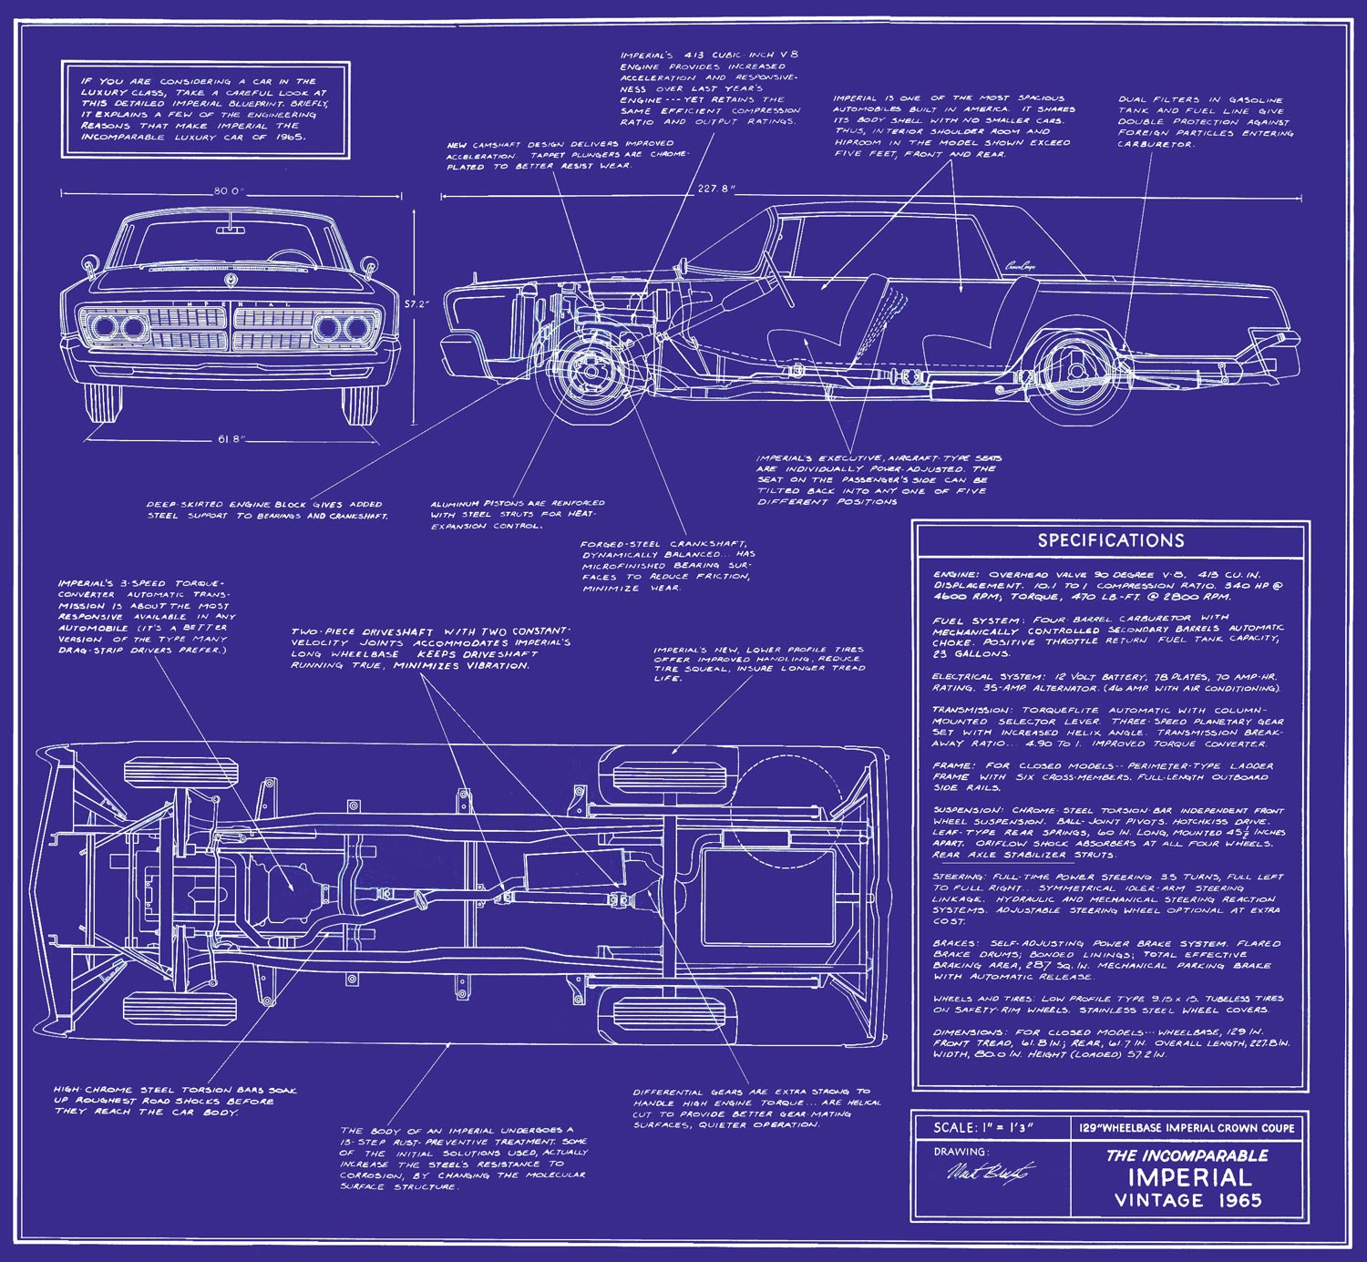
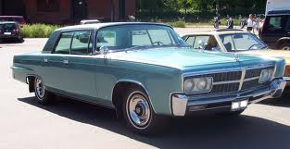
Which is the car, the design for a car?

Slide 3
Creating a Car class
Let’s say we have a Car object, myCar (which was instantiated (created) earlier)
Examples of calling possible methods to do these tasks:
myCar.drive(100);
________________;
myCar.getMiles();
_________________;

Slide 4
Planning the code for the methods:
Method Name | Parameter type and name | Return type | Accessor or Mutator?
drive(__) | double miles | void | mutator
Let’s say we have a Car object, myCar (which was instantiated (created) earlier)
Examples of calling possible methods to do these tasks:
myCar.drive(100);
myCar.addGas(20);
myCar.getMilesDriven();
myCar.getGasInTank();

Slide 5
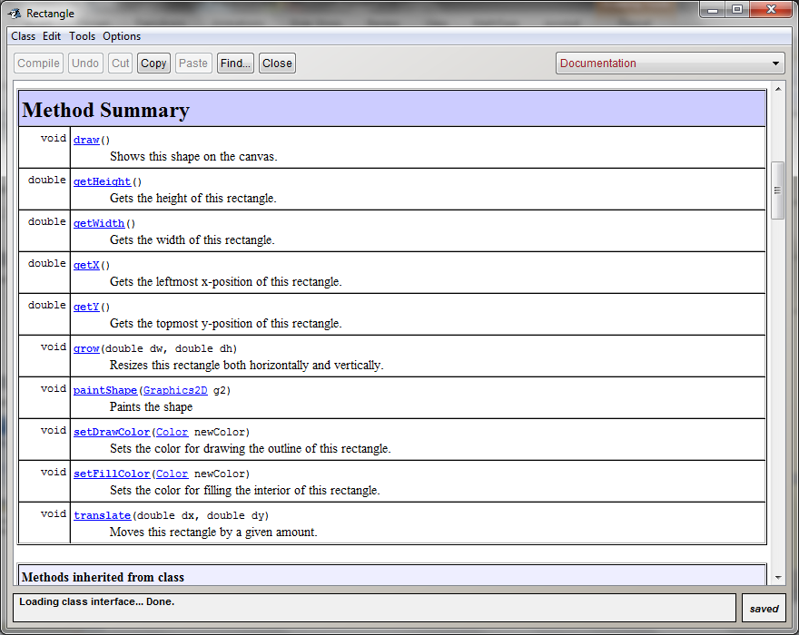
Example public interface as seen in Documentation for Rectangle class

Slide 6
Code for public interface for Rectangle class
public int getX()
public int getY()
public int getWidth()
public int getHeight()
public void translate(double dx, double dy)
public void grow(double dw, double dh)
public void setColor(Color newColor)

Slide 7
Public Interface for Car class
Methods as the user would use them:
myCar.getMilesDriven();
myCar.getGasInTank();
myCar.drive(100);
myCar.addGas(20);
Public interface for these methods in the Car class definition:
public double getMilesDriven()
___________________________
____________________________
_____________________________

Slide 8
Use this to complete Exercise 1
Instance Variables
Methods

Slide 9
Exercise 1 Continued
When we drive the car, the drive() method increases the milesDriven instance variable.
Is any other instance variable affected?
How can we include this in the drive() method?

Slide 10
Ex 1: Modify the drive() method

Slide 11
Instance Variable – valid (in scope) while object is instatiated
Local Variable – in scope only within the block (method) where it was created

Slide 12
Constructors are used to instantiate an object
Classes have private instance variable, methods (accessors & mutators) and must have constructors—to instantiate (create) objects

Slide 13
Creating a Tester Program
Calculate expected values by hand.
Actual Values:

Slide 14
Exercise 2
Add:
private instance variable named milesPerGallon
a new constructor
Change:
constructor, Car()
drive() method
Write: CarTester
Exercise 3

