Slide 1
Day 3: Objects, Methods, Documentation…
…continued!

Slide 2
Review
Classes—provide the guidelines for objects that we instantiate, or create.
We instantiate objects either in BlueJ or a special class like DaysAlivePrinter and use the new operator.
We call methods on objects using the dot operator.
We use documentation to understand the parameters methods and return types

Slide 3
We will review these ideas together before we start our first project
Notes:
Review 2 constructors, translate, grow, setColor

Slide 4
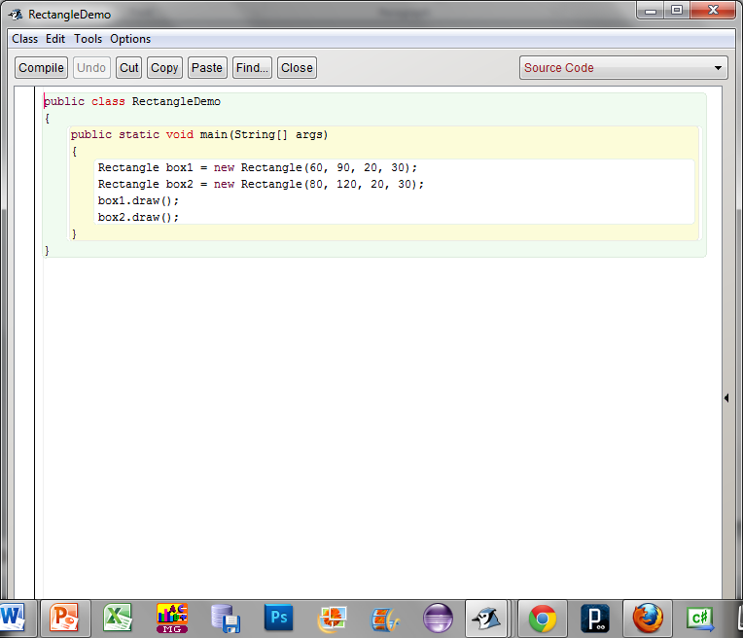
box1: Type:
What does new do?
How does Rectangle(60, 90, 20, 20) know what to do?

Slide 5
Rectangle Methods
Methods | Parameter type(s) | Return type | Accessor or Mutator?
getHeight()
getX()
translate(__,__)
grow(__,__)
toString()
setColor(___)

Slide 6
How do we answer this?

Slide 7
Exercise 1: touchingrectangles: download from Codersforcauses.com

Slide 8
Exercise 2: copyingRectangles: download from Codersforcauses.com

Slide 9
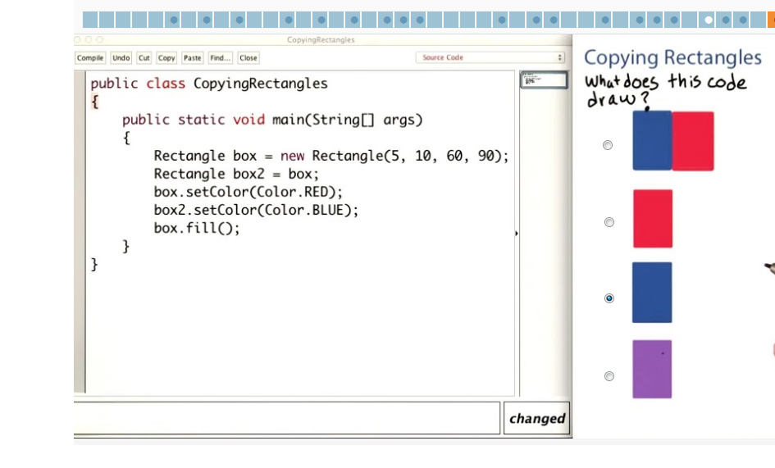
Exercise 2 Quiz

Slide 11
box.setColor(new Color(255,0,0));

Slide 12
Exercise 3:
1st: change the way that you set the color on the rectangles by using new Color(--,--,--) instead of RED or BLUE
2nd: DrawACrate

Slide 13
Exercise 4: Optional!!!
BlockTower

