Slide 1
Comparing objects booleans &&, ||and !

Slide 2
Elevator Redux—3 options
if (...)
{
System.out.println("Error: There is no thirteenth floor.");
}
else if (...)
{
System.out.println("Error: The floor must be between 1 and 18.");
}
else
{
// Now we know that the input is valid
int actualFloor = floor;
if (...)
{
actualFloor = floor - 1;
}
System.out.println("The elevator will travel to the actual floor "
+ actualFloor);
}
Or operator: ||

Slide 3
Logical operators and their return values

Slide 4
Practice with logical expressions

Slide 6
Code using logic—test that a letter is a vowel
String letter = letters.substring(i, i + 1);
// A little piece of code to get you started
// Check 'a', 'e', 'i', 'o', 'u'
if (letter.equals("a")||___________)
{
return _______;
}
else
{
return ________;
}

Slide 7
Strings are objects– do not use ==
public class EqualStrings
{
public static void main(String[] args)
{
String first = "Java";
String second = "licious";
String firstAndSecond = first + second;
String third = "Javalicious";
if (firstAndSecond==third)
{
System.out.println("They are the same");
}
else
{
System.out.println("firstAndSecond is "
+ firstAndSecond);
}
}
}
Output???

Slide 8
Objects and ==
firstAndSecond
"Javalicious";
third
"Javalicious";
== compares the memory locations stored in the two open boxes, not the contents stored in the blue boxes

Slide 9
Strings and other objects use equals()
if (firstAndSecond.equals(third)
{
System.out.println("They are the same");
}
else
{
System.out.println("firstAndSecond is "
+ firstAndSecond);
}

Slide 10
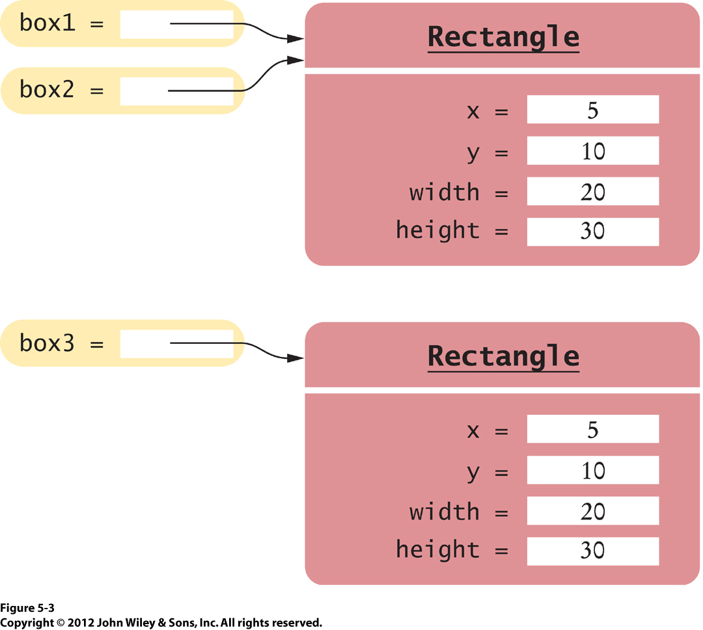
box 1 == box2 returns true
box 1 == box3 returns false

Slide 11
How do we determine if two rectangles are equal?
Rectangle box = new Rectangle(5, 10, 20, 30);
Rectangle box2 = box;
Rectangle box3 = new Rectangle(5, 10, 20, 30);
box.setColor(Color.RED);
box3.setColor(Color.RED);
box.draw();
box3.draw();

Slide 12
Write equals() method for Rectangle Class—ignore color
public boolean equals(Rectangle other)
{
if( _________&& __________ && _____&&______)
{
return true;
}
else
{
return false;
}
}
this keyword is helpful!

Slide 13
This keyword in action
/**
Constructs a new Color object.
@param red the red value of the color (between 0 and 255)
@param green the green value of the color (between 0 and 255)
@param blue the blue value of the color (between 0 and 255)
*/
public Color(int theRed, int theGreen, int theBlue)
{
red = theRed;
green = theGreen;
blue = theBlue;
}

Slide 14
More this and other
/**
Constructs a new Color object.
*/
public Color(Color other)
{
this.red = other.red;
this.green = other.green;
this.blue = other.blue;
}
Not calling methods, accessing instance variables

Slide 15
What do you expect to see?
public class DayTester
{
public static void main(String[] args)
{
Day theFourth = new Day(2013, 7, 4);
Day julyFour = new Day(2013, 7, 4);
String answer = "false";
if (theFourth == julyFour){answer = "true";}
System.out.println("Actual: "+answer);
System.out.println("Expected: true");
}
}

Slide 16
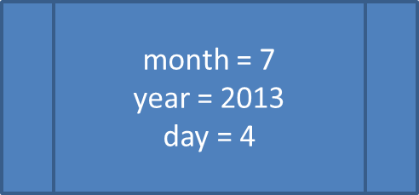
How would we write an equals method for testing two days: eg: theFourth.equals(julyFour);
theFourth
julyFour
month = 7
year = 2013
day = 4

